Slide 1







Slide 2
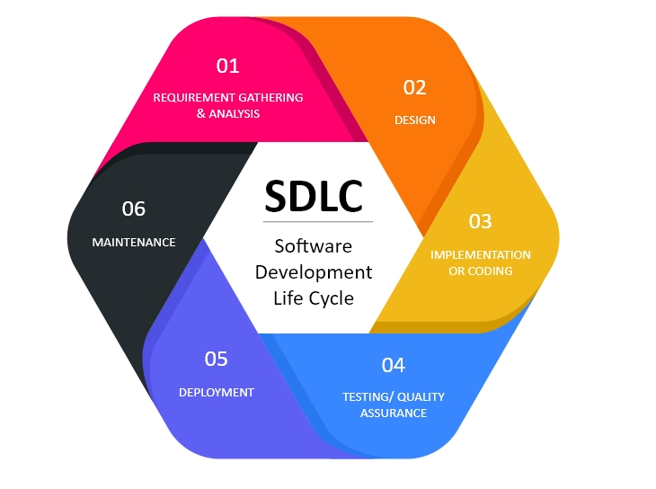
SDLC (Software Development Life Cycle)

Slide 3
SDLC (Software Development Life Cycle)
SDLC is a structured process for the production of high-quality, low-cost software, in the shortest possible production time
SDLC Phases
1) Requirement Analysis and Planning
2) Design
3) Development
4) Testing
5) Deployment
6) Maintenance

Slide 4
SDLC Phases
Requirement Analysis and Planning
To identify the expectation of the user/client for an application/software that has to be newly built or modified.
Recognition of the risks involved is also done at this stage.
The outcome of this phase is requirement documents FRD (Functional requirement Document) or BRD (Business Requirement Document), the naming convention of the document varies in each and every organization.
BRD - Business Requirement Document
The Business/Client/other Stakeholders provide a requirement.
One requirement can be small or big.
If its a big requirement has to be broken wherever it requires and taken as multiple requirements.
FRD - Functional Requirement Document:
The Process to reach the expectancy of the BRD is an FRD.
How to develop the expected requirement, What are the features and Functionalities or Tools / Systems used and what sort of inter-dependencies they have.
And how the systems will react with the two newly created system when they start working together when this Functionality takes place.
What are the Assumptions a BA has made and what are the Limitation the system will have if went with the current approach.
It will be helpful if there are any supporting Process Flow-charts / Flow diagrams etc..
The Business Requirement Document (BRD) describes the high-level business needs whereas the Functional Requirement Document (FRD) outlines the functions required to fulfill the business need. BRD answers the question what the business wants to do whereas the FRD gives an answer to how should it be done. FRD is derived from a BRD.

Slide 5
SDLC Phases
Design
High-level Design
Brief description of the overall architecture of the application with the integrated modules
Macro level design
Converts business requirements to high level solution
Solution Architect creates it before any other tech documentation
Results: database design, functional design, review record
Low-level Design
Detailed description about each and every module with functional logic, interfaces, and Database Tables which was mentioned in HLD
Micro level design
Convers high level solution to detailed solution
Designers & Developers creates it after the high level design document
Results: program specification and unit test plan
Development
Developers start to build the entire system by developing code. In the coding phase, tasks are divided into units or modules and assigned to the various developers

Slide 6
SDLC Phases
Testing
After completion of development, the testing team starts testing the functionality of the entire system.
This is done to verify that the entire application works according to the customer’s requirements. During this phase, QA and testing team may find some bugs/defects which they communicate to developers.
The development team fixes the bug and sends it back to QA for a re-test. This process continues until the software is bug-free, stable, and working according to the business needs of that system.
Deployment
Once testing is completed, the application meets the client’s requirement then deployment of the application will be done in the Production Environment
Maintenance
Customers/ End users start using the application/Software, Enhancements or bug fixes will be done based on the user’s feedback.

Slide 7
Life Cycle Models
Waterfall Model
V- Model Model

Slide 8
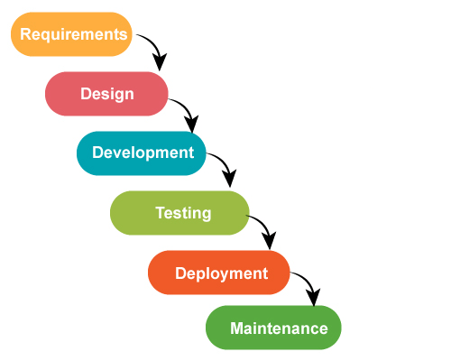
Waterfall Model
Linear sequential Model. The next phase begins only after the completion of the previous Phase

Slide 9
Advantages of Waterfall Model
Each and every phase is clearly defined and there is no overlapping of the phases as it is a step-by-step process.
Each phase is completely done one at a time.
Requirements are clear to everyone at the beginning of the project
Works well for the smaller projects and gets complicated for large projects.
Clear planning of project team structure reduces the problematic issues.
Release date and final cost will be calculated before starting the project.
Best suitable for small projects as the requirements are clearly stated.

Slide 10
Disadvantages of Waterfall Model
The problem in Adapting Changes to the Requirement
Time to market for the product is high
Testing is delayed since it is the fourth phase
Integration is done at the end
Not suitable for complex projects
Clients valuable feedback cannot be included with the ongoing development phase

Slide 11
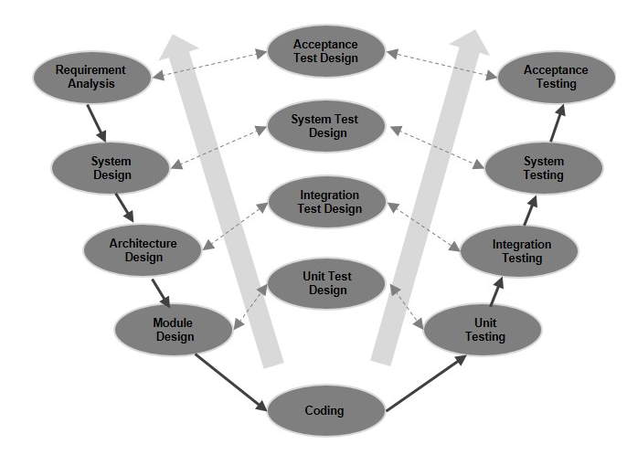
V-Model (Verification and Validation Model)

Slide 12
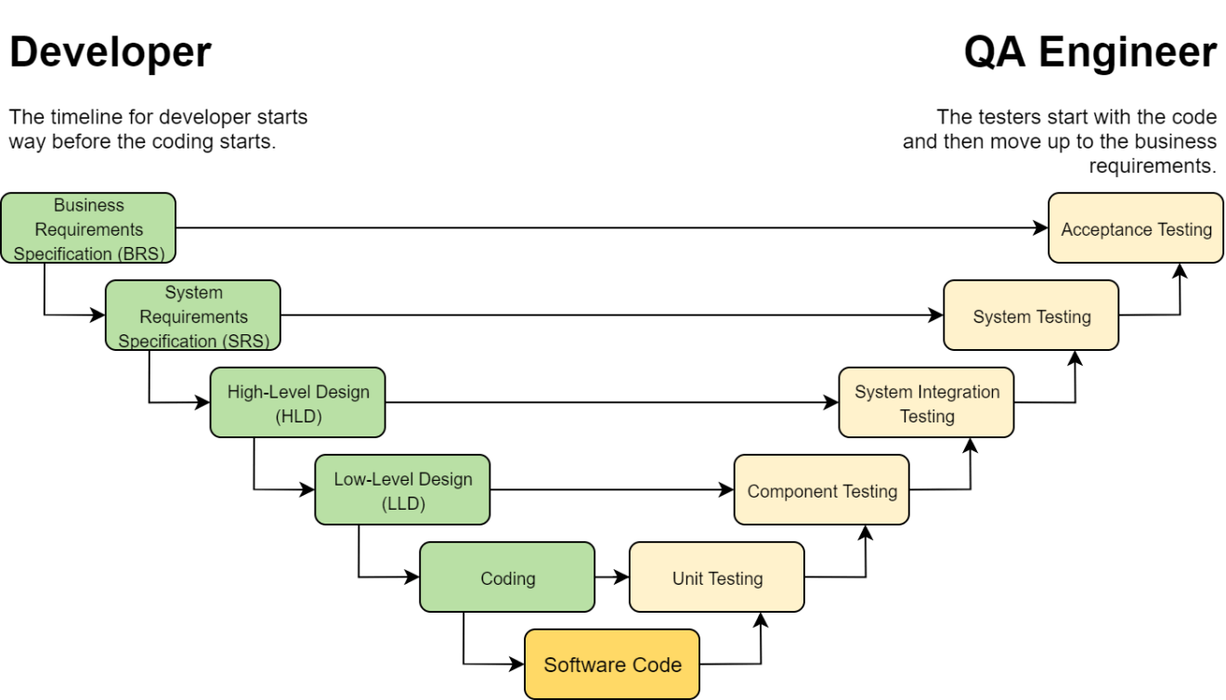

V-Model (Verification and Validation Model)

Slide 13
V-Model (Verification and Validation Model)
Verification:
Static Testing process. Develop the Testcases at all levels with respect to the requirement document to ensure that the Business requirement is satisfied before the development of the application
Validation:
Dynamic Testing Process which has been done once after the development of code has been completed with respect to the application developed.

Slide 14
Advantages of V Model
Testing Methods like planning, test designing happens well before coding.
This saves a lot of time. Hence a higher chance of success over the waterfall model.
Avoids the downward flow of the defects.
Works well for small plans where requirements are easily understood.

Slide 15
Disadvantages of V Model
High risk and uncertainty.
Not a good model for complex and object-oriented projects.
Poor model for long and ongoing projects.
Not suitable for the projects where requirements are at a moderate to high risk of changing.
Once an application is in the testing stage, it is difficult to go back and change a functionality.
No working software is produced until late during the life cycle.

Slide 16


